Slide 1

Unit 1 Introduction to Fintech
Mrs.Disha Sushant Wankhede
disha.wankhede@viit.ac.in
Department of Computer Engineering
BRACT’S, Vishwakarma Institute of Information Technology, Pune-48
(An Autonomous Institute affiliated to Savitribai Phule Pune University)
(NBA and NAAC accredited, ISO 9001:2015 certified)

Slide 2
Objective/s of this session
To Introduce FinTech and it’s sub sectors
To Explain the classification of various models of FinTech
To Describe the innovation in FinTech
To Introduce an innovative Fin Tech strategy
To Study the development of FinTech Application and about future trends in Fin Tech
After completion of the course, student will be able to
1. Understand what FinTech is and the sub sectors that comprise it.
2. Classify various models of the Fintech
3. Illustrate various innovations done using latest technology trends in FinTech.
4. State the Critical Success Factors in Fin Tech.
5. Be able to adopt an innovative Fin Tech strategy within their own organization to lead a digital transformation project.
6. Develop the application using the concepts of FinTech as a case study
Learning Outcome/Course Outcome
Department of Computer Engineering, VIIT, Pune-48

Slide 3
Unit I: Introduction to Fintech
Introduction, Financial Services and Fintech: Introduction, Changing Environment, Customer Centricity, Digital Transformation, Definition of Fintech, History of Fintech, Fintech stages, An Overview of Fintech Initiatives Around the World, Ecosystems, Ranking National Ecosystems, Downsides of Disruptive Fintech Initiatives.
Unit II: Model and Classifications
Introduction, Classification, Five Ws and one H : 1. Why a fintech initiative was born? 2. For whom was it born? 3. Which are the services it aims to provide? 4. Where does it aim to perform its business? 5. When does it aim to operate, within the framework of the financial cycle? 6. How is fintech working? The organization and its elements, The V4 business model framework, A Business Model, A Business Model for Fintech, Revenue—Focus on Customer Lifetime Value, Components of an effective marketing plan.
Unit III: Fintech Innovation
Introduction, Innovation and Fintech, Digital Transformation and Fintech, A model for an integrated innovation strategy, Types of Innovation : Product (or services), Process, Organization, Business models, Examples of Innovation, Fintech business model canvas, Process Innovation : Big Data Analytics, Value Creation from Big Data Analytics, Kreditech’s self-learning algorithm, Internet of Things, Blockchain Technology, Organizational Innovation: Social Networks, Business Model Innovation, Robots, The V4 business model framework for Kreditech, Virtual Currencies, Technology Acceptance Model.

Slide 4
Unit IV: Critical Success Factors
The Model, Low-Profit Margin, Agility, Scalability, Security Management, Innovation, Ease of Compliance, Metrics, Fintech and Financial Services, Structure of fintech initiatives, The Challenges, Aspects to Consider, A Cooperation Model, Open Innovation
Unit V: Regulations
The Role of the Regulators, Equal Treatment and Competition, The Risks to Consider, Regtech, A Business Model for Insurtech Initiatives, Drivers of Disruption, The Impact of Technology, Insurance and Technology: Insurtech, Application of the Model to the Insurance Industry, The Empowerment of Customers, Mobility in Support of Insurance Companies, Digital Wholesale Insurance,
Unit VI: A Case Study
Introduction, Robotica, Business Model Canvas, The Value Proposition, Customer Experience, Channels, Processes and Activities, Resources and Systems, Partnership and Collaborations, Revenues, Costs and Investments, The Future: Financial Services as Platforms

Slide 5
Unit 1 Contents
Part A :
Introduction,
Financial Services
Fintech: Introduction,
Changing Environment,
Customer Centricity,
Part B
Digital Transformation
Definition of Fintech
History of Fintech
Fintech stages
An Overview of Fintech Initiatives Around the World
Part C
Ecosystems,
Ranking National Ecosystems,
Downsides of Disruptive Fintech Initiatives.
Mrs.Disha Wankhede Department of Computer Engineering, VIIT, Pune-48

Slide 6
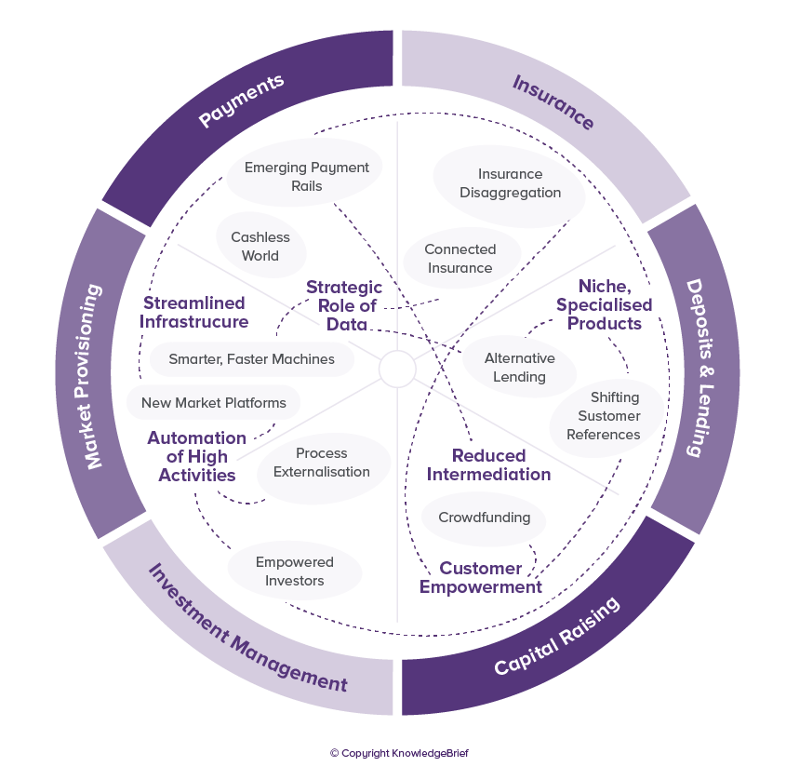
So What is Fintech
Finance + Technology
“New financial industry that applies technology to improve financial activities”
Technologies, Methodologies, Companies, Business Models, New Services …
Mrs.Disha Wankhede Department of Computer Engineering, VIIT, Pune-48

Slide 7
Definition
Financial technology (abbreviated fintech or FinTech) is the technology and innovation that aims to compete with traditional financial methods in the delivery of financial services.
It is an emerging industry that uses technology to improve activities in finance.
The use of smartphones for mobile banking, investing, borrowing services, and cryptocurrency are examples of technologies aiming to make financial services more accessible to the general public. (https://empirica-software.com/fintech-companies-lending/)
Financial technology companies consist of both startups and established financial institutions and technology companies trying to replace or enhance the usage of financial services provided by existing financial companies.
Mrs.Disha Wankhede Department of Computer Engineering, VIIT, Pune-48

Slide 8
Here are the top fintech startups in the country:
Paytm.
Paytm Money.
PhonePe.
MobiKwik.
PayU.
ETMoney.
PolicyBazaar.
LendingKart.
MyWay
Sharekhan
Mrs.Disha Wankhede Department of Computer Engineering, VIIT, Pune-48

Slide 9
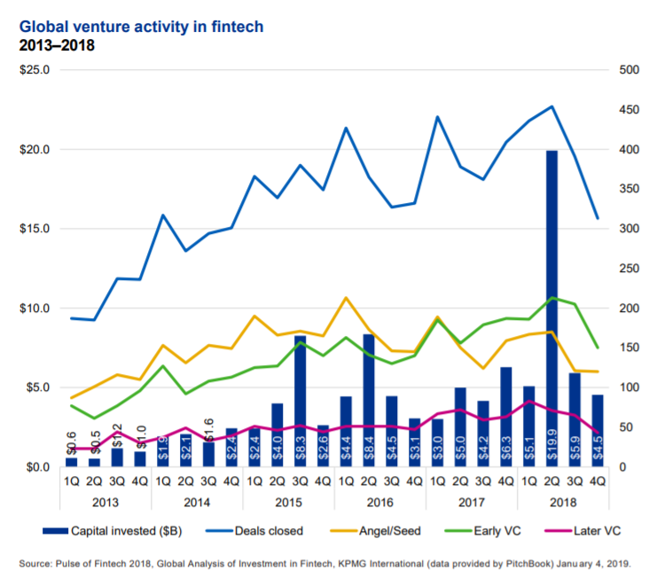
Number
Business Transactions Group (M&A(mergers & acquisitions )/PE(private equity)/VC(venture capital)
https://assets.kpmg/content/dam/kpmg/xx/pdf/2019/02/the-pulse-of-fintech-2018.pdf
Mrs.Disha Wankhede Department of Computer Engineering, VIIT, Pune-48

Slide 10
Global investment in financial technology increased.
Then ascent financial technology industry in London has seen rapid growth over the last few years, according to the office of the Mayor of London.
Forty percent of the City of London's workforce is employed in financial and technology services.
Mrs.Disha Wankhede Department of Computer Engineering, VIIT, Pune-48

Slide 11
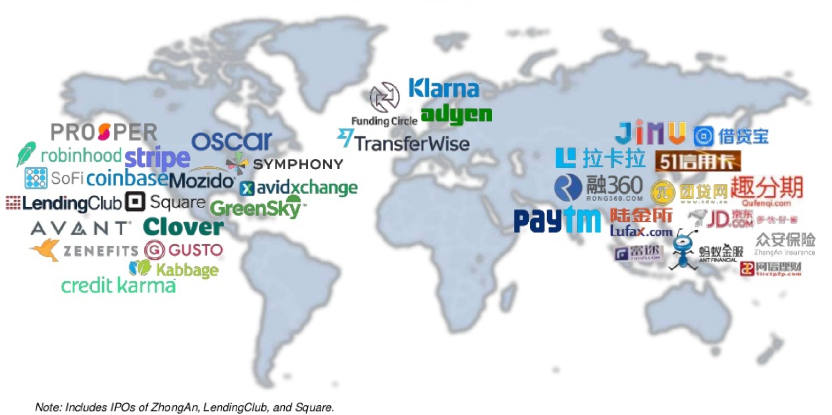
Numbers
26 Unicorns
# Source: CBInsights
Mrs.Disha Wankhede Department of Computer Engineering, VIIT, Pune-48

Slide 12
Fintech technology has been used to automate Investment, Insurance, Banking Service and Risk Management
The services may originate from various independent service providers including at least one licensed bank or insurer.
In trading on capital markets, innovative electronic trading platforms facilitate trades online and in real time.
Social trading networks allow investors to observe the trading behavior of their peers and expert traders and to follow their investment strategies on currency exchange and capital markets.
The platforms require little or no knowledge about financial markets, and have been described as disruptors which provide "a low-cost, sophisticated alternative to traditional wealth managers" by the World Economic Forum.
Mrs.Disha Wankhede Department of Computer Engineering, VIIT, Pune-48

Slide 13
To be continued in next session
Part A :
Introduction,
Financial Services
Fintech: Introduction,
Changing Environment,
Customer Centricity,
Part B
Digital Transformation
Definition of Fintech
History of Fintech
Fintech stages
An Overview of Fintech Initiatives Around the World
Part C
Ecosystems,
Ranking National Ecosystems,
Downsides of Disruptive Fintech Initiatives.
Mrs.Disha Wankhede Department of Computer Engineering, VIIT, Pune-48

Slide 14
Digital Transformation and Fintech
A new application of digital initiatives, such as marketing
• A matter of using technology to drive business process innovation
• Nothing less than to be the Uber of taxi or the Airbnb of hoteling, and more
business’ 4 Cs—context, customers, challenges and costs, and competitors—so that they can have a clear view of how digital transformation, technologies, and customer behavior can affect their organizations in the years to come
Mrs.Disha Wankhede Department of Computer Engineering, VIIT, Pune-48

Slide 15
Digital Transformation and Fintech
the digital transformation, it is important to look at the 3 Ps
Products: The definition of services to be offered to the customers of the organization is really essentially.
Processes: The introduction of new products needs to consider also the changes in the processes. The two goes together in an innovation.
People: Finally yet importantly, people must deploy and deliver the innovation. Executives should devote to them a very strong consideration.
Mrs.Disha Wankhede Department of Computer Engineering, VIIT, Pune-48

Slide 16
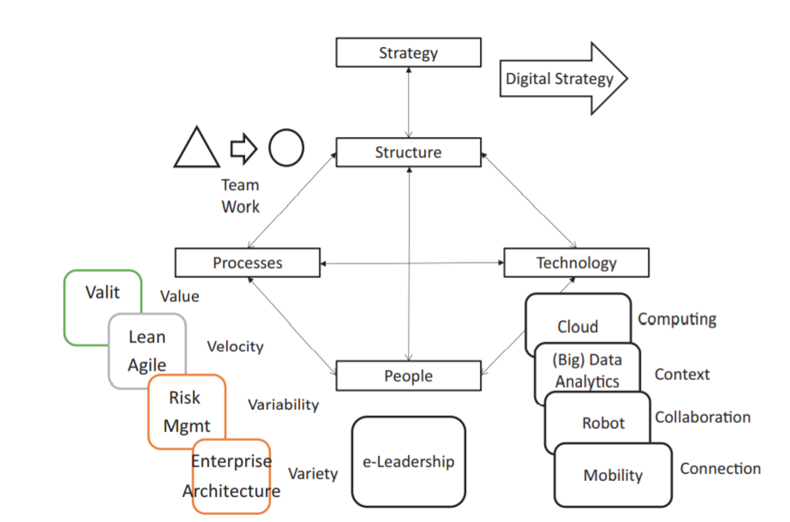
Digital Transformation and Fintech
Mrs.Disha Wankhede Department of Computer Engineering, VIIT, Pune-48

Slide 17
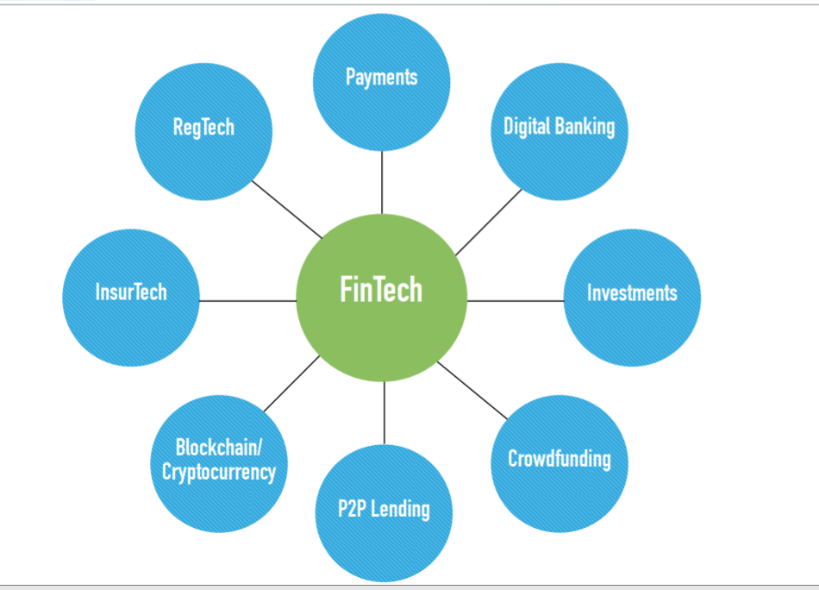
Fintech Universe
Mrs.Disha Wankhede Department of Computer Engineering, VIIT, Pune-48

Slide 18
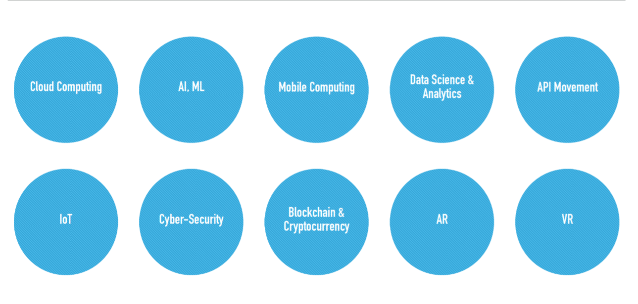
Technologies
Mrs.Disha Wankhede Department of Computer Engineering, VIIT, Pune-48

Slide 19
The financial services industry, some of the used technologies include artificial intelligence (AI), big data, robotic process automation (RPA), and blockchain.
Artificial Intelligence is a blanket term for many different technologies.
In terms of the "fintech" industry, AI is used in various forms. AI algorithms can be used to predict changes in the stock market and give insight into the economy.
AI is used to provide insight on customer spending habits and allows financial institutions to better understand their clients.
Chatbots are another AI-driven tool that banks are starting to use to help with customer service.
Big Data is another "fintech" technology that financial institutions utilize.
In the finance sector, big data can be used to predict client investments and market changes and create new strategies and portfolios.
Big Data can be used to analyze customer spending habits and therefore improve fraud detection.
Big Data helps banks create segmented marketing strategies and can be used to optimize the operations of a company.
Mrs.Disha Wankhede Department of Computer Engineering, VIIT, Pune-48

Slide 20
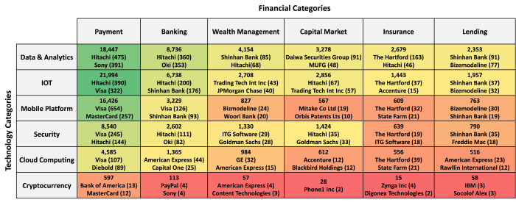
U.S Patents Related Fintech(2015)
Mrs.Disha Wankhede Department of Computer Engineering, VIIT, Pune-48

Slide 21
According to Gomedici the US was the most active market for FinTech in 2015 – the most recent year for which information is available – with a total of 45,410 patents, followed by Japan with 16,978 and Korea with 9,902.
In the same year, according to IAM Media, the top patent holders in FinTech were financial services organisations, such as VISA, at the top of the list with 1,342, followed by Bank of America, with 1,052 and Hitachi, with 1,048.
2018 IBM, is leading the way with 23,864 FinTech related patents.
FinTech Fast Track Initiative was launched in Singapore early last year by the Intellectual Property Office of Singapore
Mrs.Disha Wankhede Department of Computer Engineering, VIIT, Pune-48

Slide 22
The top technology areas for granted patents in FinTech are:
Finance
Exchange, e.g. stocks, commodities, derivatives or currency exchange.
Special adaptations for electronic funds transfer systems
Banking, e.g. interest calculation, credit approval, mortgages etc.
Investment, e.g. financial instruments or portfolio and fund management
Insurance, e.g. risk analysis or pensions
The FinTech landscape is continuing to grow and evolve
Mrs.Disha Wankhede Department of Computer Engineering, VIIT, Pune-48

Slide 23
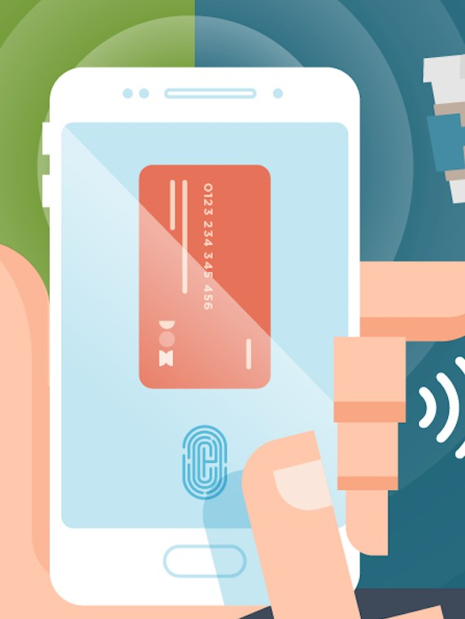
Payments
Mrs.Disha Wankhede Department of Computer Engineering, VIIT, Pune-48

Slide 24
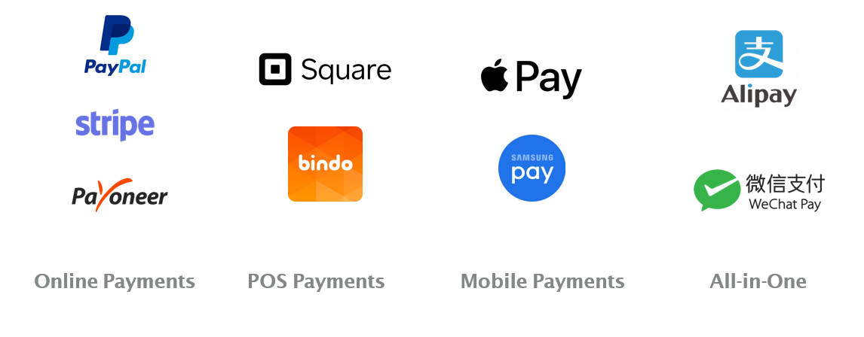
Payments
Mrs.Disha Wankhede Department of Computer Engineering, VIIT, Pune-48

Slide 25
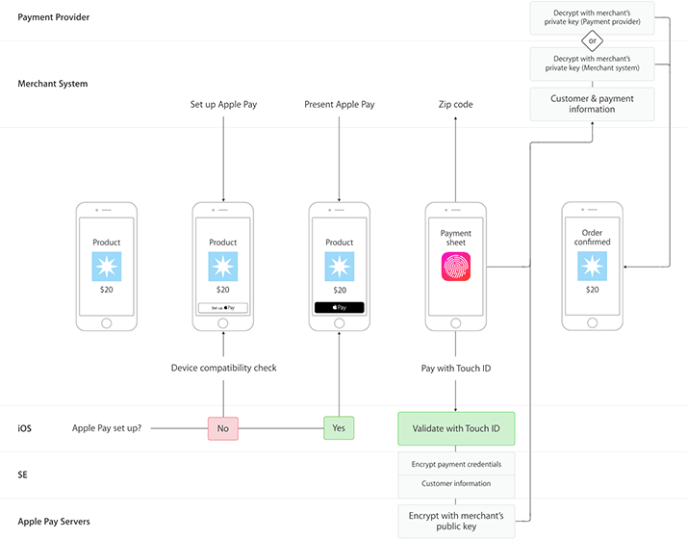
How does apple pay work
▸ No credit card information is ever stored on iPhone or Apple servers (even in encrypted form).
▸ EMV Payment Tokenization
https://www.tokenex.com/blog/emv-payment-tokenization
Mrs.Disha Wankhede Department of Computer Engineering, VIIT, Pune-48

Slide 26
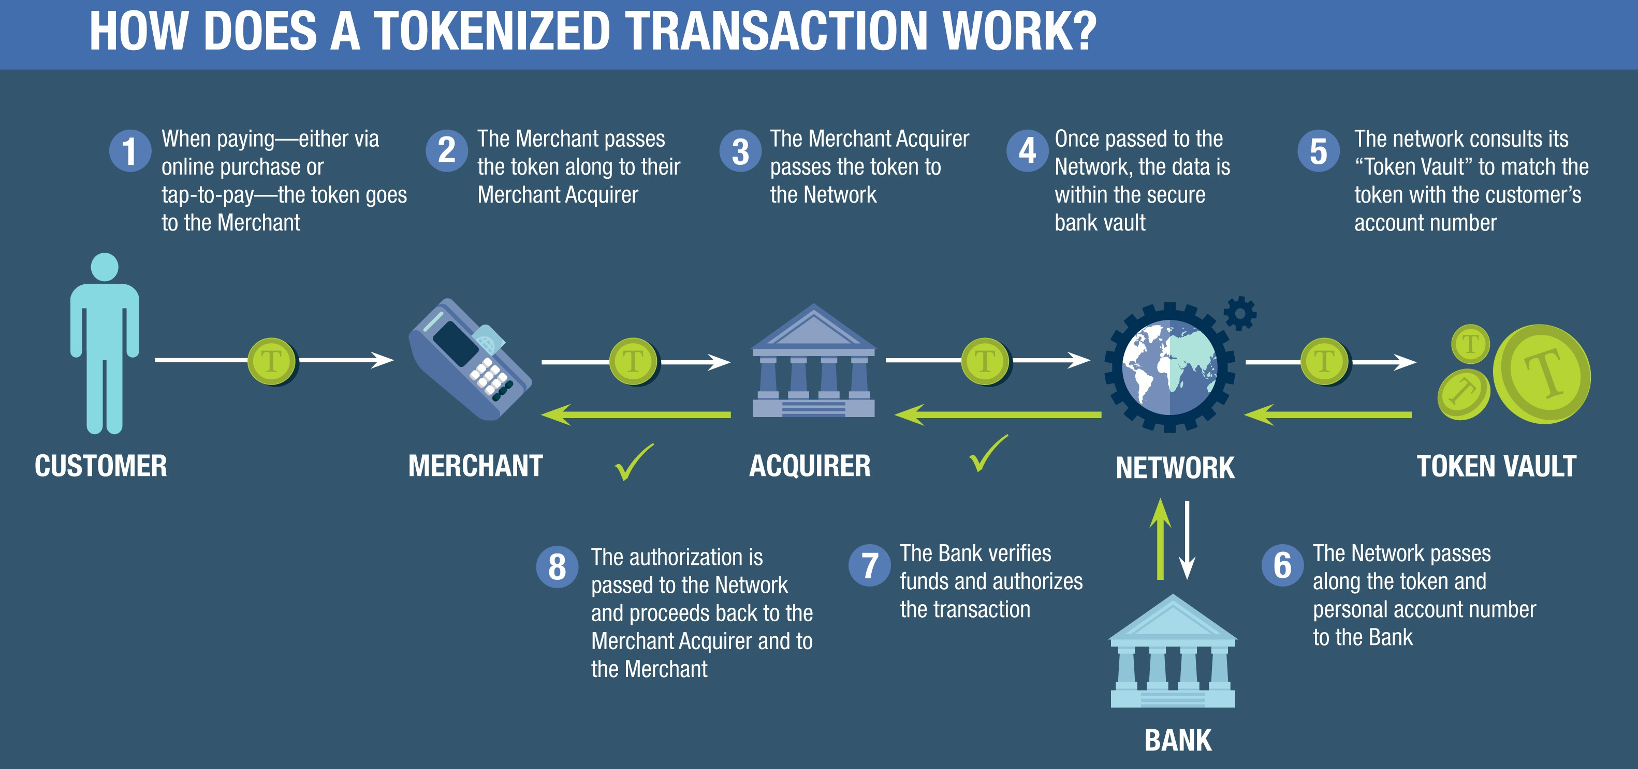
Tokenization
Mrs.Disha Wankhede Department of Computer Engineering, VIIT, Pune-48

Slide 27
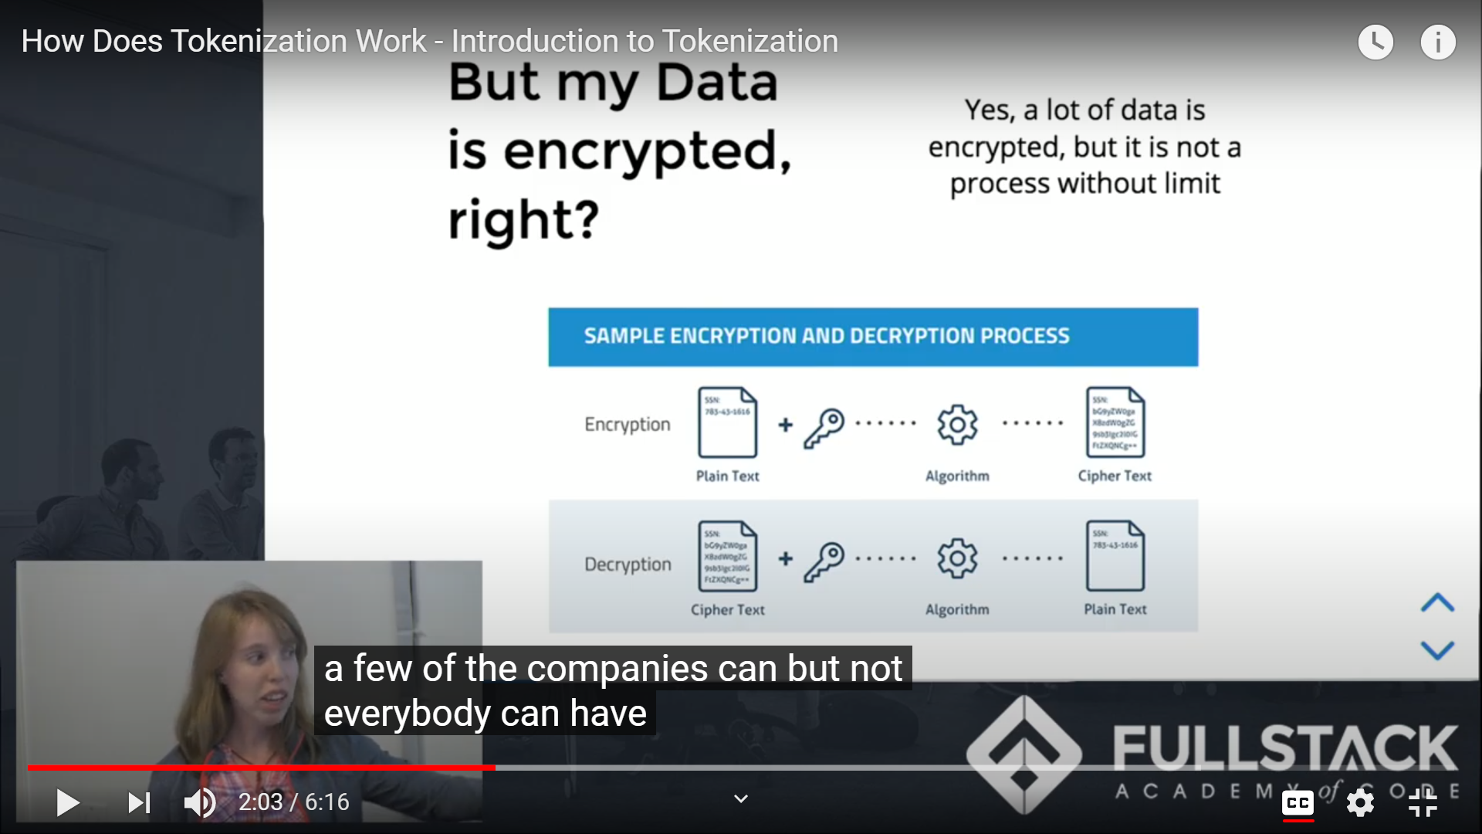
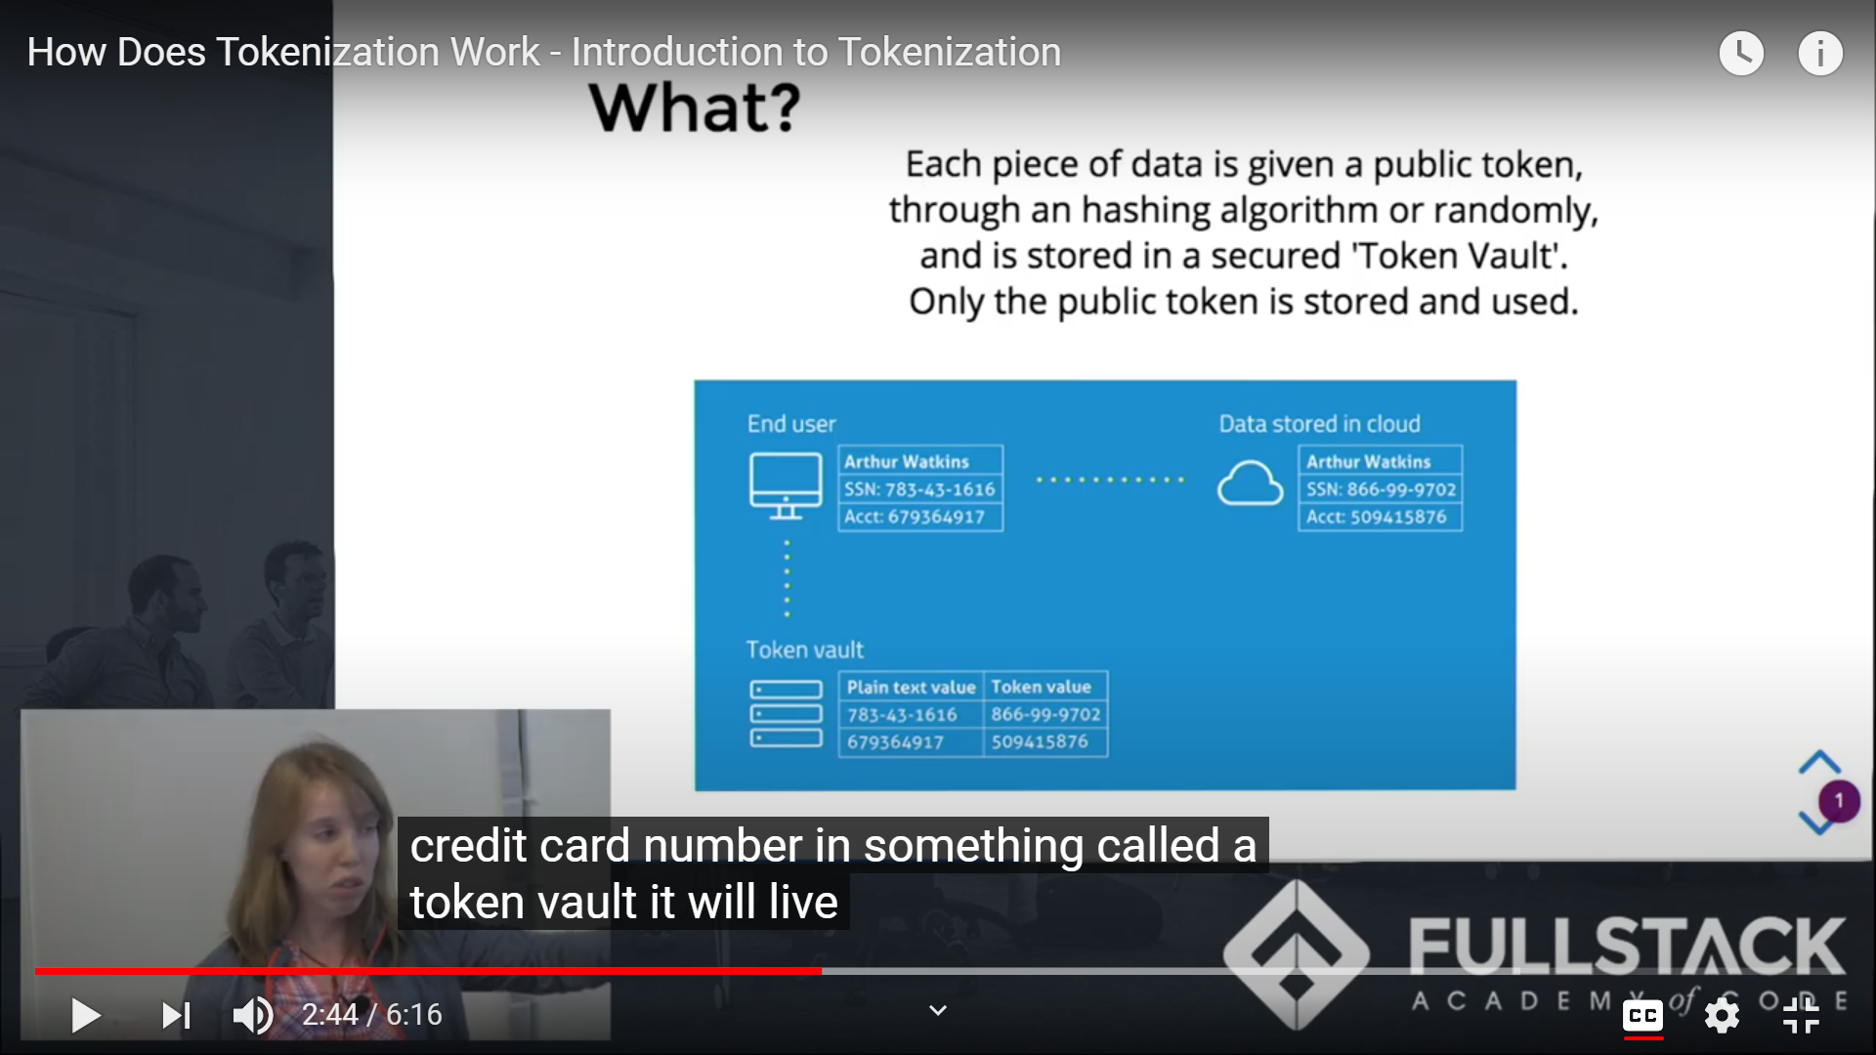
Mrs.Disha Wankhede Department of Computer Engineering, VIIT, Pune-48

Slide 28
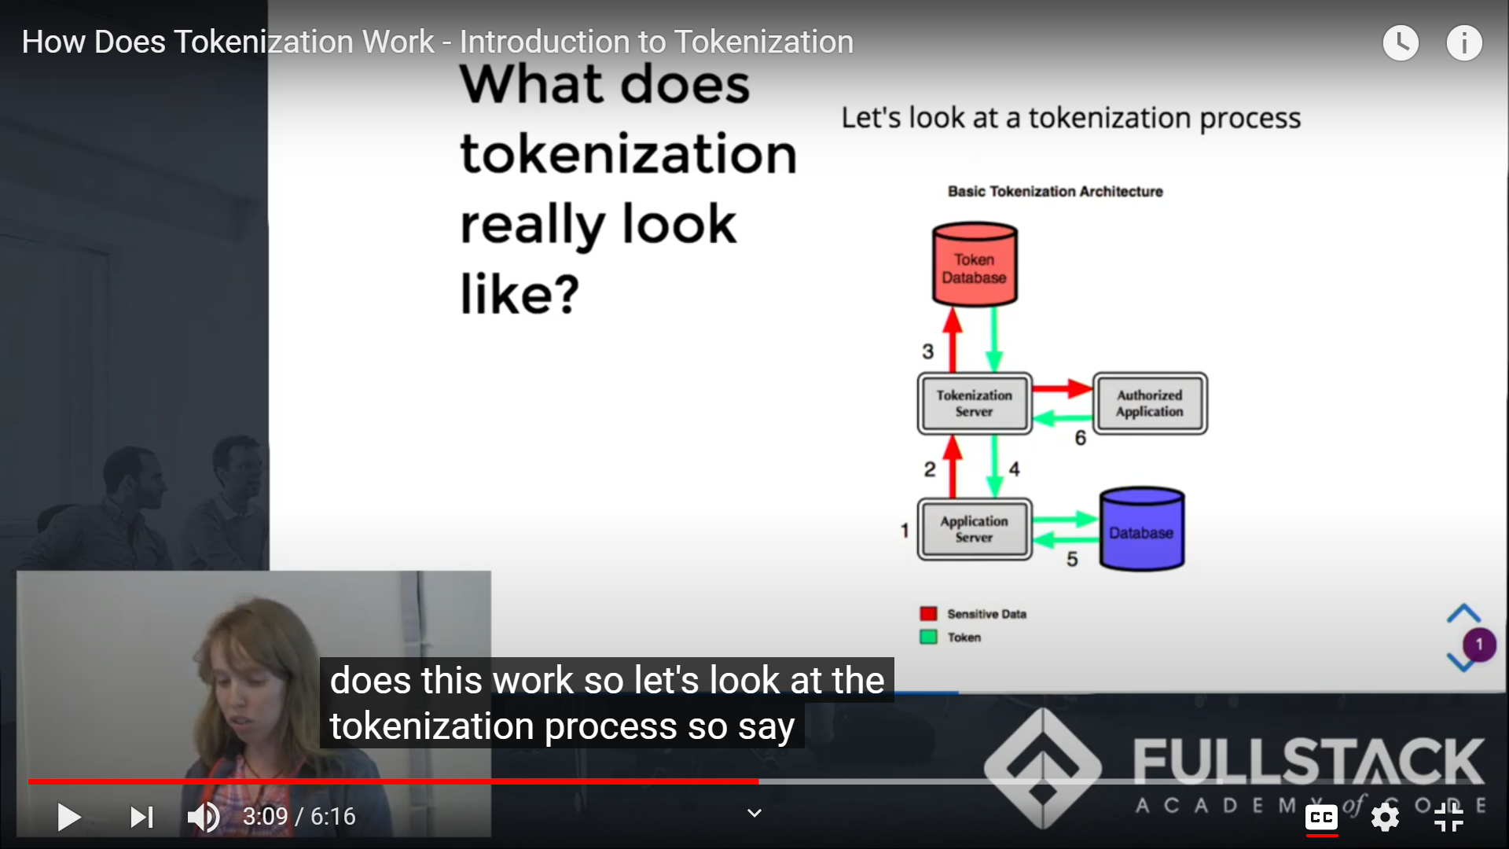
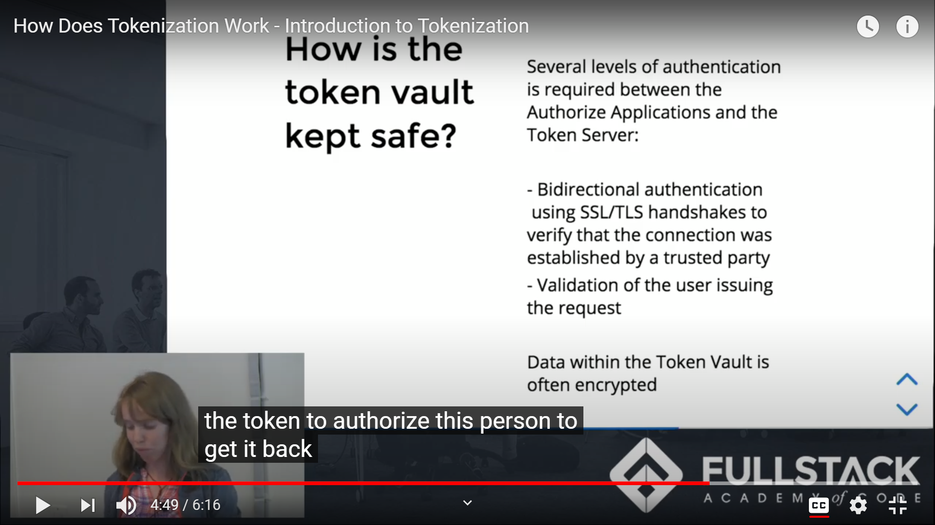
Mrs.Disha Wankhede Department of Computer Engineering, VIIT, Pune-48

Slide 29


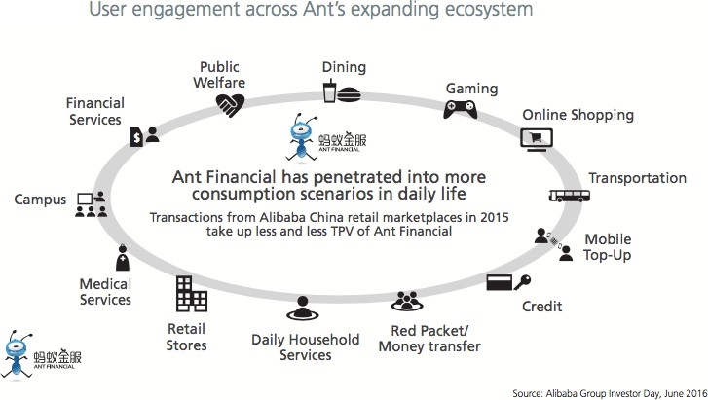
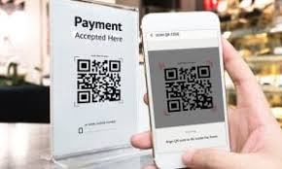
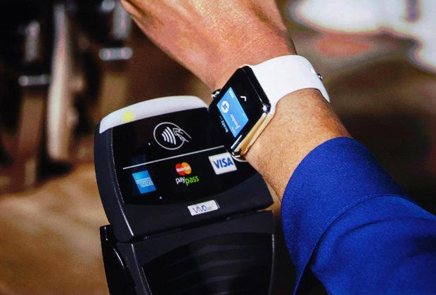
Cashless payment and beyond …
Mrs.Disha Wankhede Department of Computer Engineering, VIIT, Pune-48

Slide 30

Digital Banking
Mrs.Disha Wankhede Department of Computer Engineering, VIIT, Pune-48

Slide 31
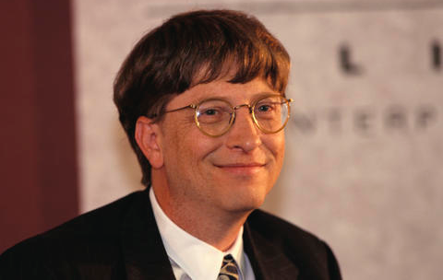
Banking is necessary but banks are not
BillGates 1994
Mrs.Disha Wankhede Department of Computer Engineering, VIIT, Pune-48

Slide 32
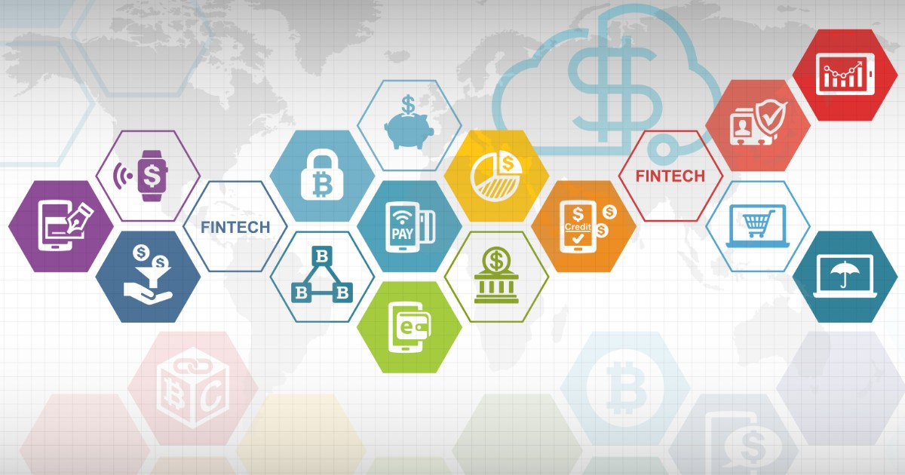
Still Banking ,But Better
▸ Money Deposits, Withdrawals, and Transfers
▸ Checking/Saving Account Management
▸ Applying for Financial Products
▸ Loan Management
▸ Bill Pay
▸ Account Services
Mrs.Disha Wankhede Department of Computer Engineering, VIIT, Pune-48

Slide 33






Lending Players
Digital Banking
Virtual Banking
3-party Platforms/Vendors
Technology for Better Banking
Mrs.Disha Wankhede Department of Computer Engineering, VIIT, Pune-48

Slide 34
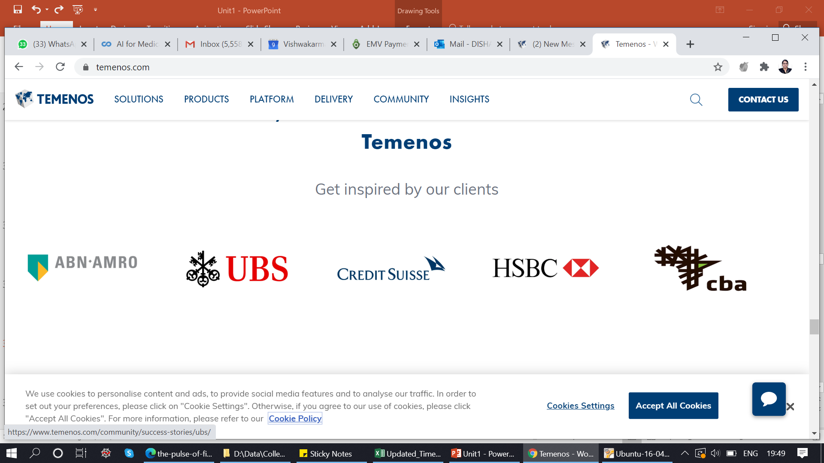
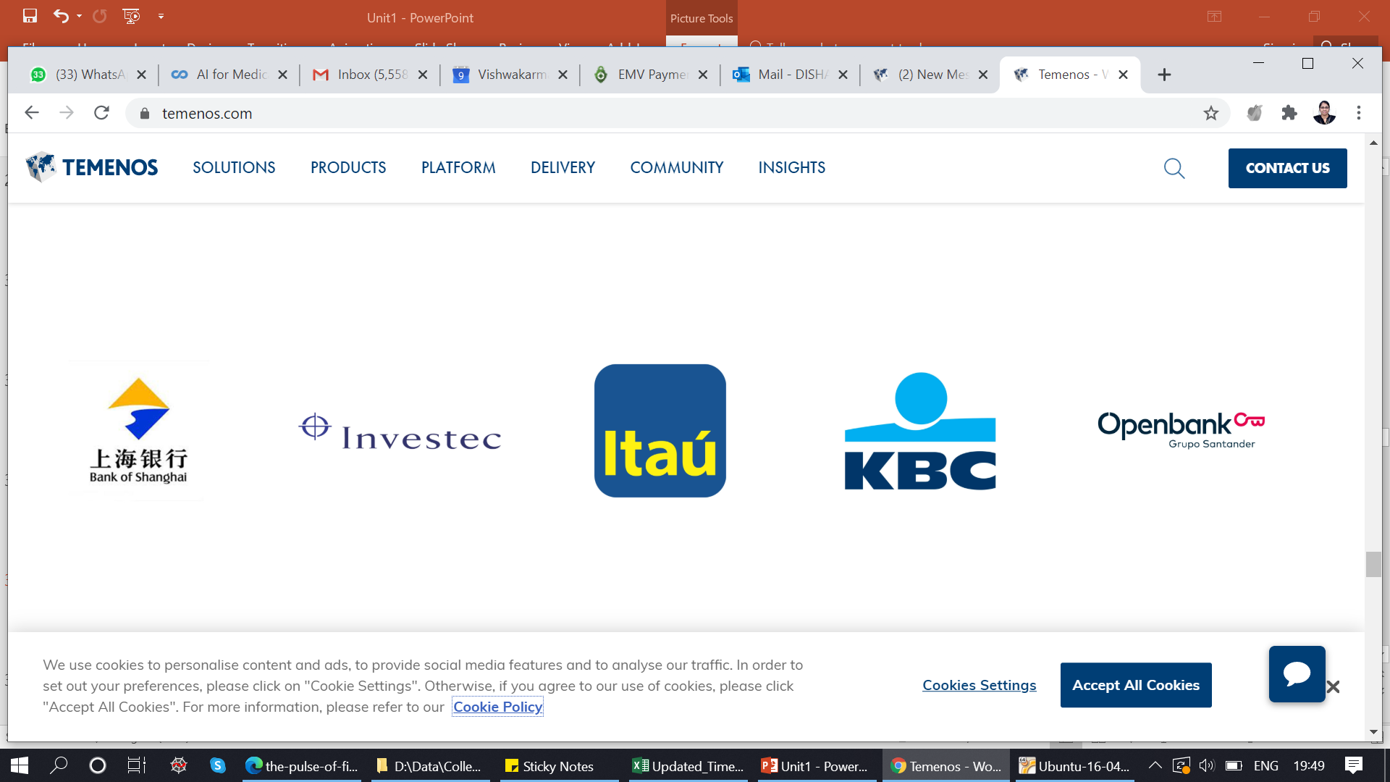
Mrs.Disha Wankhede Department of Computer Engineering, VIIT, Pune-48

Slide 35

Investment
Mrs.Disha Wankhede Department of Computer Engineering, VIIT, Pune-48

Slide 36
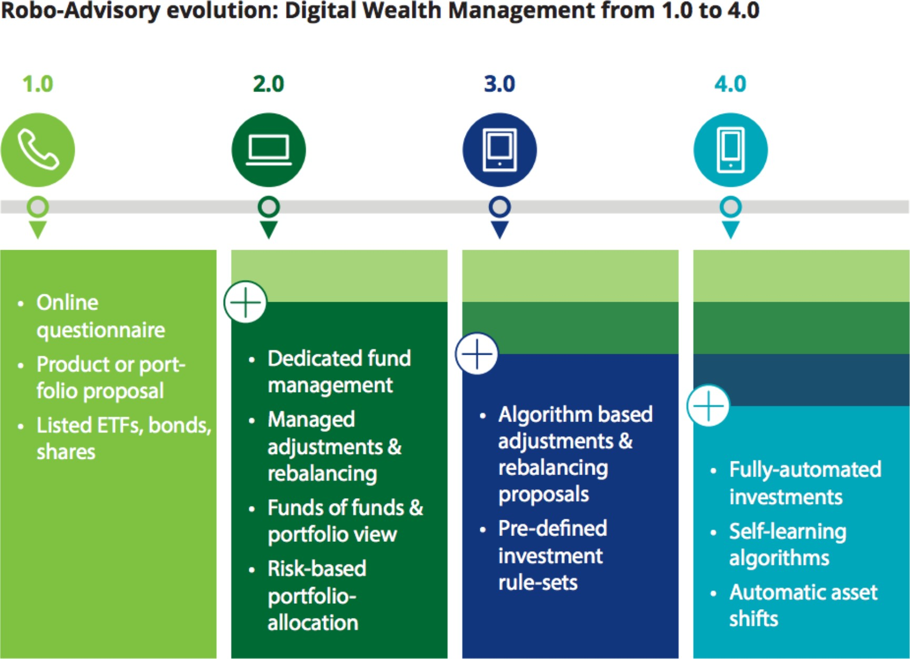




Digital Wealth Management Evolution
▸ Online portfolio management solution that aims to invest client assets by automating client advisory.
Mrs.Disha Wankhede Department of Computer Engineering, VIIT, Pune-48

Slide 37
Robo Advisor Key Tech
Advise/Engagement
Asset Management
Interactive UX
Chatbot
NPL
Voice Recognition
eKYC
User Profiling
eSignature/Contracts
Model Management
Big Data
Machine Learning
Artificial Intelligence
Data Platform
Mrs.Disha Wankhede Department of Computer Engineering, VIIT, Pune-48

Slide 38

Crowd Funding
Mrs.Disha Wankhede Department of Computer Engineering, VIIT, Pune-48

Slide 39
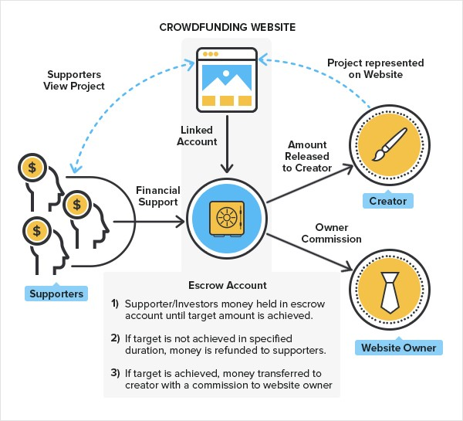













Crowd Funding Model
Reward-based Model
Donation-based Model
Equity-based Model
Lending-based Model
Source: FATBit
Mrs.Disha Wankhede Department of Computer Engineering, VIIT, Pune-48

Slide 40
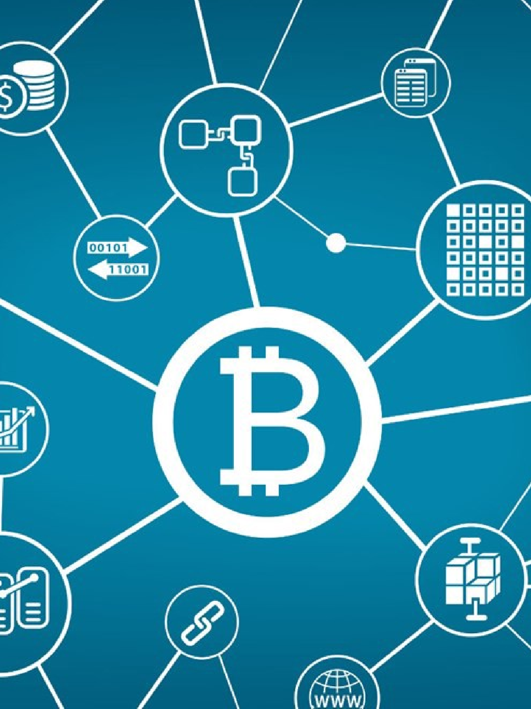
Blockchain/Cryptocurrency
Mrs.Disha Wankhede Department of Computer Engineering, VIIT, Pune-48

Slide 41
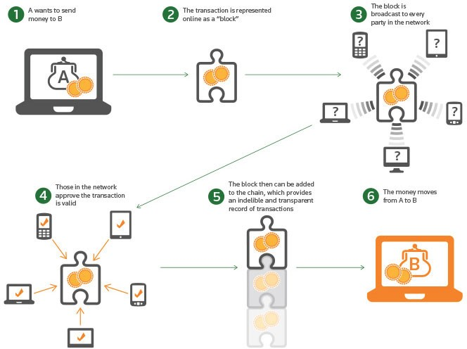



Block chain Explained
▸ Decentralized
▸ Digitalized
▸ Cryptographically Sealed
▸ Consensus-based
▸ Chronological & Timestamped
▸ Distributed, public ledger
Mrs.Disha Wankhede Department of Computer Engineering, VIIT, Pune-48

Slide 42
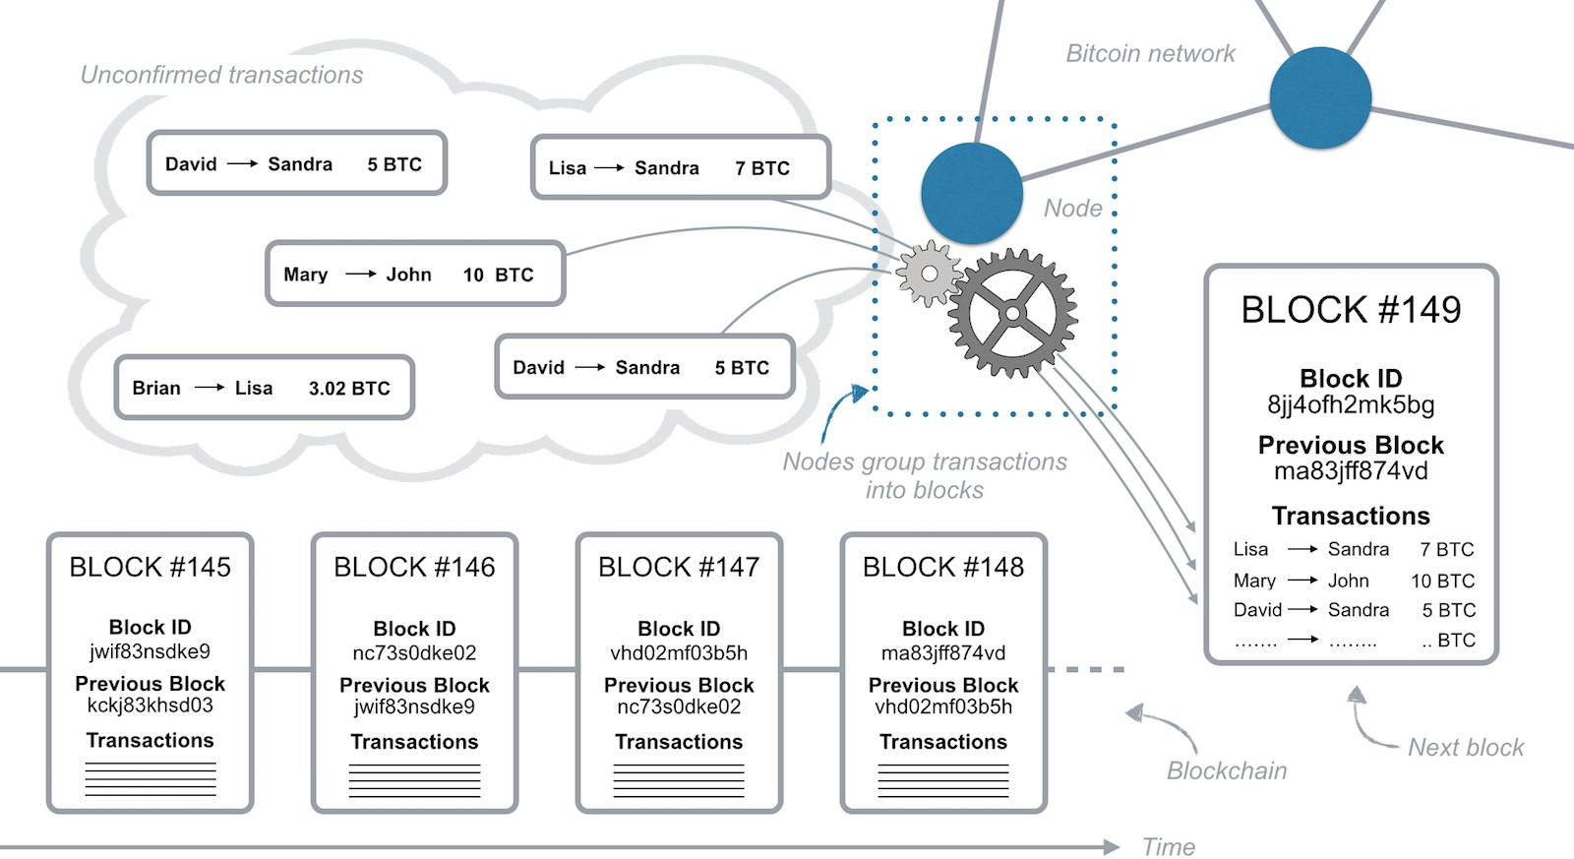
Block chain Structure
https://www.investopedia.com/terms/b/blockchain.asp
Mrs.Disha Wankhede Department of Computer Engineering, VIIT, Pune-48

Slide 43
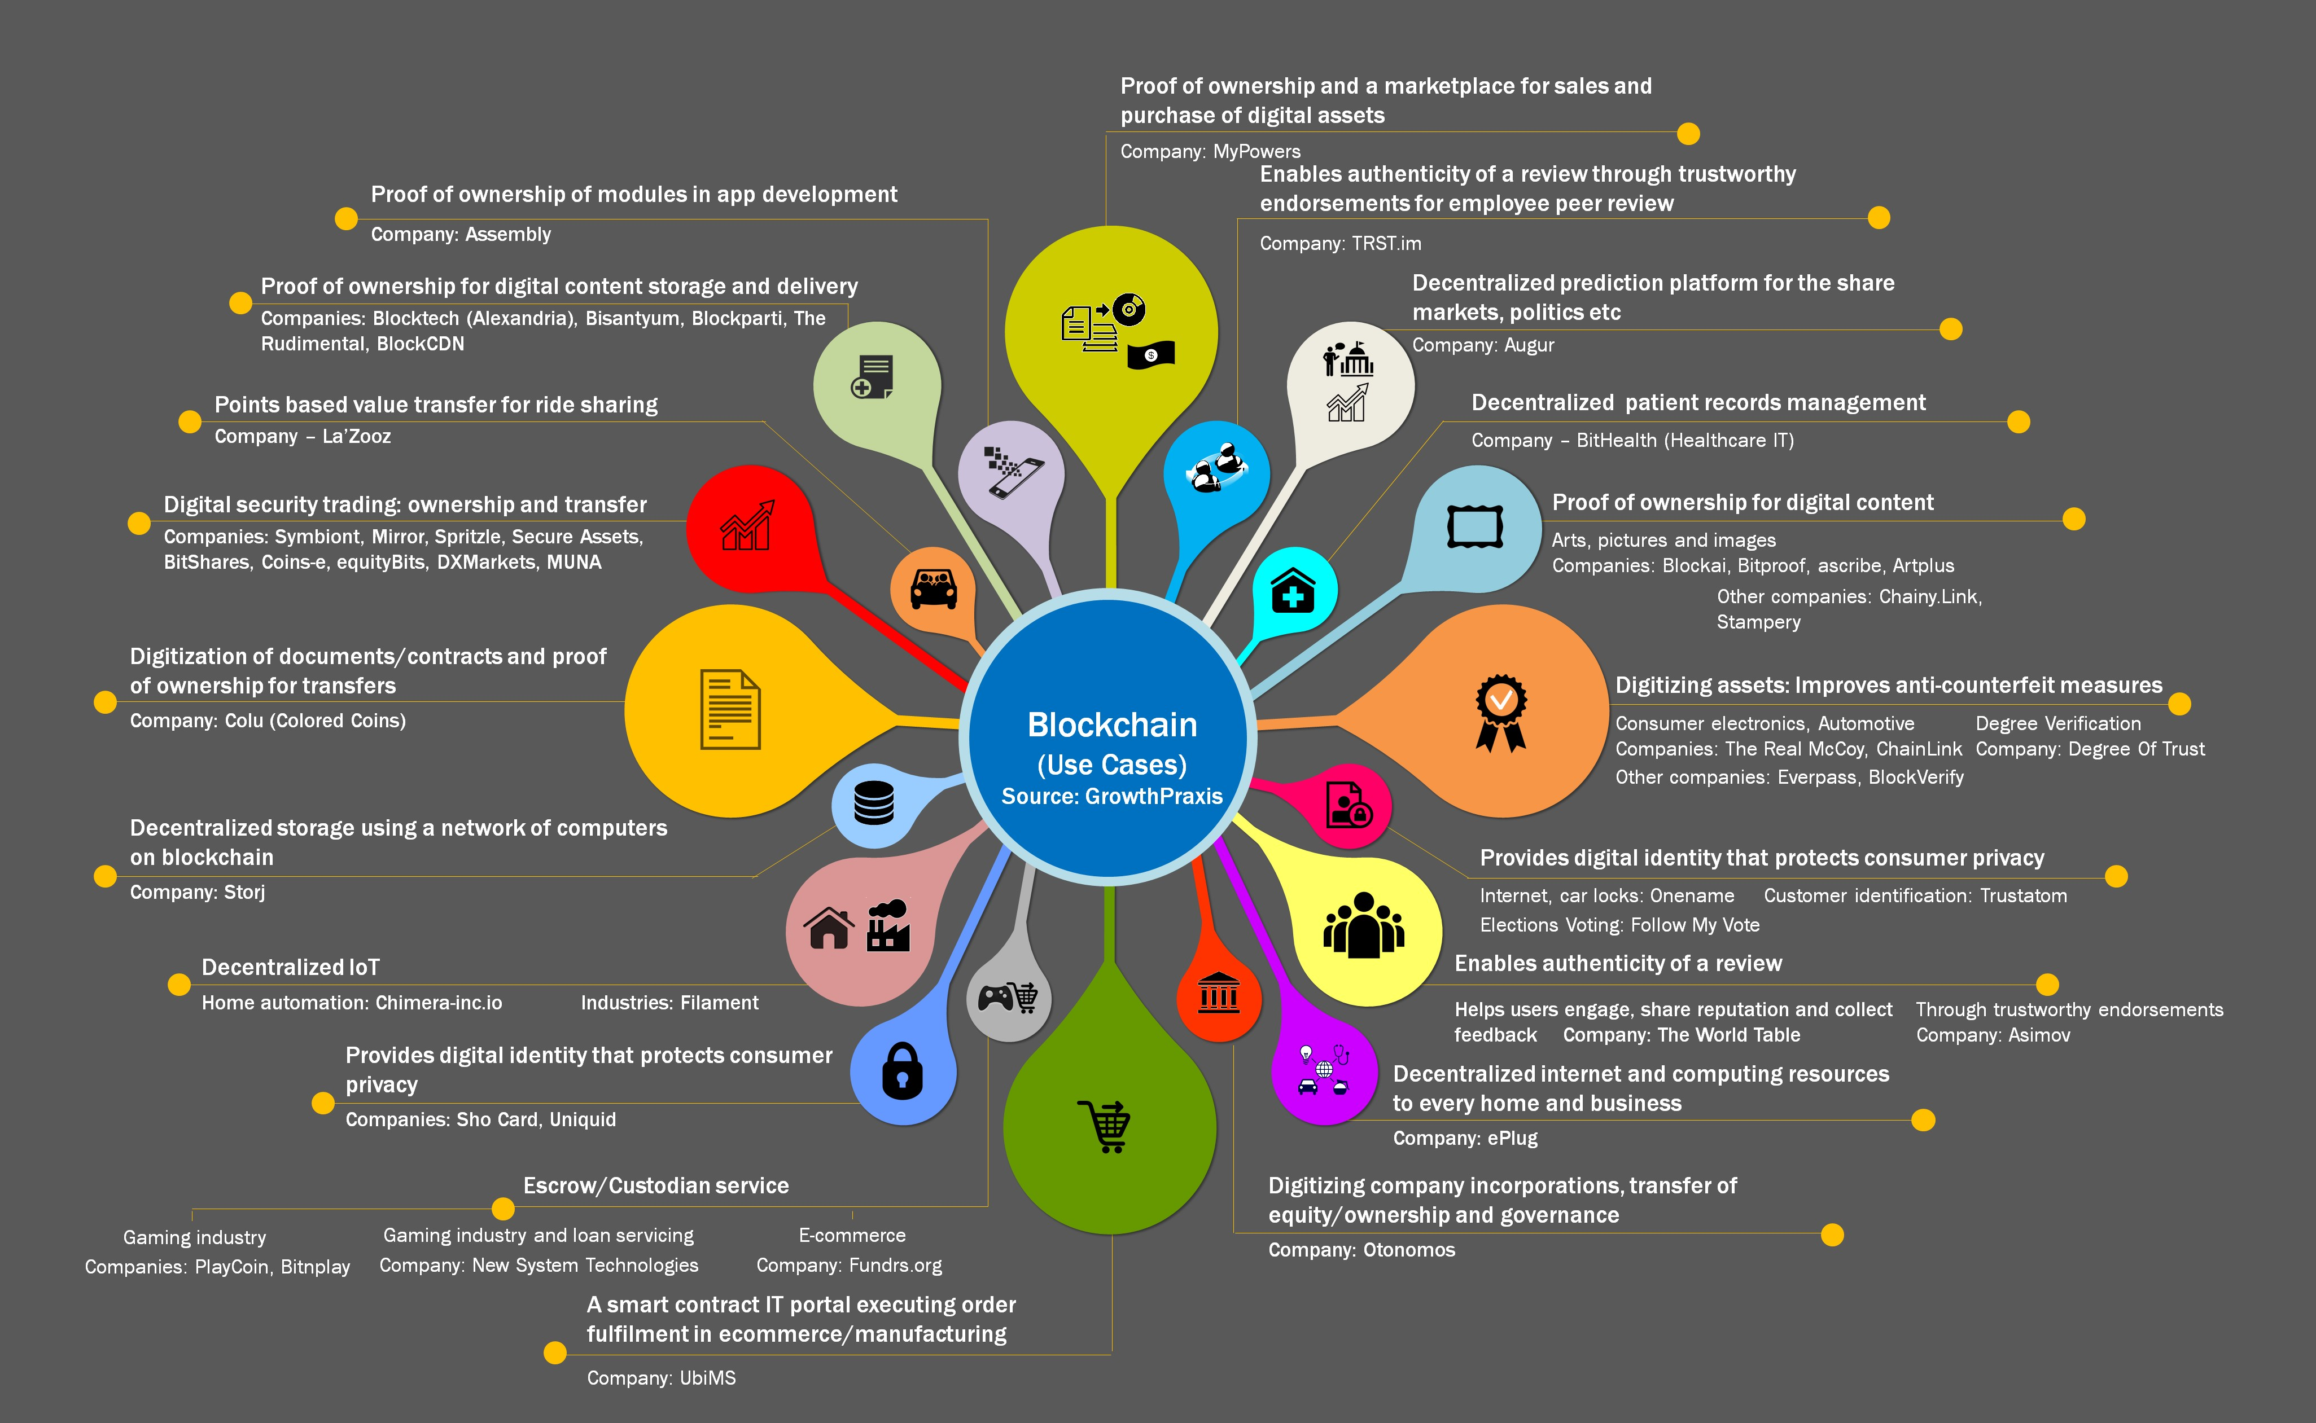
Broader Application
Mrs.Disha Wankhede Department of Computer Engineering, VIIT, Pune-48

Slide 44

Insurance Tech
Mrs.Disha Wankhede Department of Computer Engineering, VIIT, Pune-48

Slide 45
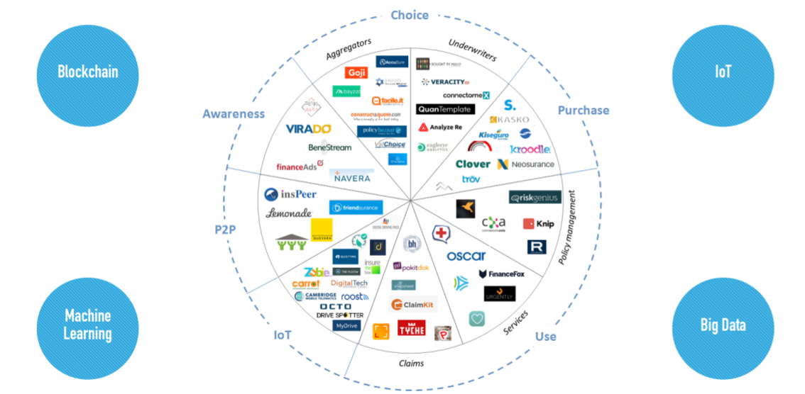
Insurtech Ecosystem
Mrs.Disha Wankhede Department of Computer Engineering, VIIT, Pune-48

Slide 46


Regulation Tech
Mrs.Disha Wankhede Department of Computer Engineering, VIIT, Pune-48

Slide 47

We the people want our money safer than our selfies
PayPal, 2014
Mrs.Disha Wankhede Department of Computer Engineering, VIIT, Pune-48

Slide 48
RegTech Universe
RegTech (Regulatory Technology) is more than a buzzword, it is a very real movement that is already having an impact on regulatory compliance.
Regulatory and technological developments are changing the nature of financial markets, services, and institutions in ways completely unexpected before the 2008 global financial crisis (GFC).
Mrs.Disha Wankhede Department of Computer Engineering, VIIT, Pune-48

Slide 49
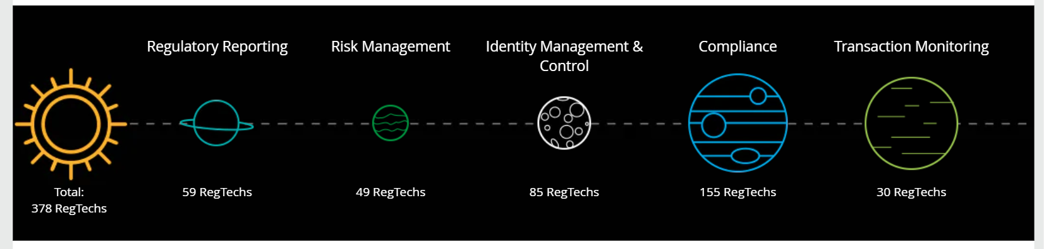
RegTech Universe
Mrs.Disha Wankhede Department of Computer Engineering, VIIT, Pune-48

Slide 50
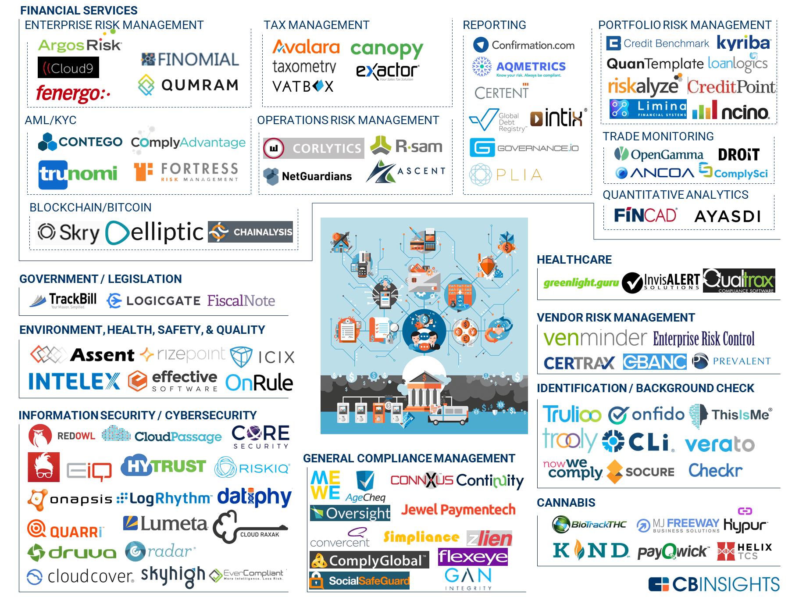
Regulation Tech
Mrs.Disha Wankhede Department of Computer Engineering, VIIT, Pune-48

Slide 51
Fintech stages
The period of fintech 1.0.(around 1866 to 1967)
1967, the development of digital technology.
1987 at the latest, not only highly globalized, but also digitized. This period of fintech 2.0 continued until 2008.
Since 2008, a new stage has started (fintech 3.0).
Nowadays, industry 4.0 is a vision of an increased connection between physical and virtual industrial machines.
Mrs.Disha Wankhede Department of Computer Engineering, VIIT, Pune-48

Slide 52
To be continued in next session
Part A :
Introduction,
Financial Services
Fintech: Introduction,
Changing Environment,
Customer Centricity,
Part B
Digital Transformation
Definition of Fintech
History of Fintech
Fintech stages
An Overview of Fintech Initiatives Around the World
Part C
Ecosystems,
Ranking National Ecosystems,
Downsides of Disruptive Fintech Initiatives.
Mrs.Disha Wankhede Department of Computer Engineering, VIIT, Pune-48

Slide 53
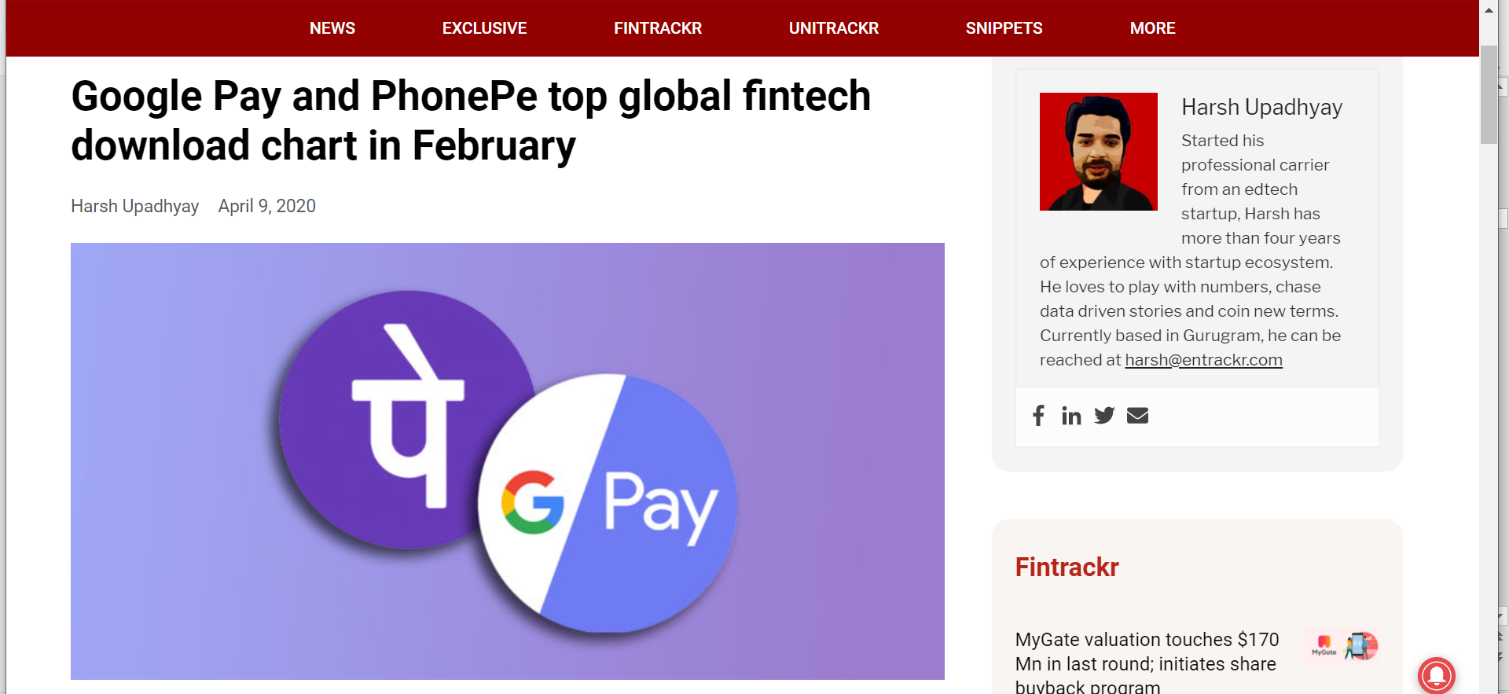

Slide 54
FINTECH ECOSYSTEM
The consultancy company Ernst & Young (EY) ranked the most relevant fintech ecosystems from a worldwide perspective. It identified four core ecosystem attributes, to which it is necessary to add “solutions” as the fifth one:
(1) Demand (2) Talent (3) Capital (4) Policy (5) Solutions
Mrs.Disha Wankhede Department of Computer Engineering, VIIT, Pune-48

Slide 55
FINTECH ECOSYSTEM…Continue
(1) The demand attribute is the result of the interactions built between customers, financial institutions, corporates, and governments.
(2) The talent attribute depends on universities and other educational institutions, technology and financial institutions, and entrepreneurs operating their businesses in sectors with a high level of correlation with financial technology.
(3) The solutions attribute depends on the technological companies, the academia, and, potentially, on crowdsourcing.
(4) The capital attribute depends on three main categories of investors:
angel investors, or business angels
venture capital investors
IPO (initial public offering) investors
Mrs.Disha Wankhede Department of Computer Engineering, VIIT, Pune-48

Slide 56
FINTECH ECOSYSTEM…Continue
(5) The policy attribute refers not only to the specific policy environment but also to the effectiveness of the tax incentives and government programs: the ordinary stakeholders belonging to this area are regulators and governments.
Mrs.Disha Wankhede Department of Computer Engineering, VIIT, Pune-48

Slide 57
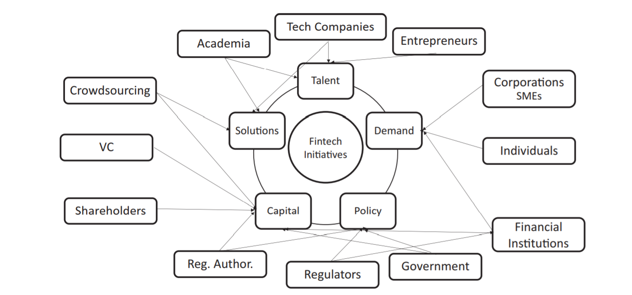
Mrs.Disha Wankhede Department of Computer Engineering, VIIT, Pune-48

Slide 58
Ranking National/International Ecosystems
In Europe, $1.5 billion was invested in financial technology companies in 2014.
Stockholm is the second highest funded city in Europe in the past 10 years.
Europe's fintech deals reached a five-quarter high, rising from 37 in Q4 2015 to 47 in Q1 2016.
Lithuania has issued 51 fintech licenses since 2016,
Fintech companies in the United States raised $12.4 billion in 2018, a 43% increase over 2017
In the Asia Pacific region, the growth will see a new financial technology hub to be opened in Sydney, in April 2015
Mrs.Disha Wankhede Department of Computer Engineering, VIIT, Pune-48

Slide 59
Ranking National Ecosystems…Continue
While Singapore has been one of the central Fintech hubs in Asia, start ups in the sector from Vietnam and Indonesia have been attracting more venture capital investments in recent years.
Since 2014, Southeast Asian Fintech companies have increased VC funding from $35 million to $679 million in 2018 and $1.14 billion in 2019
Mrs.Disha Wankhede Department of Computer Engineering, VIIT, Pune-48

Slide 60
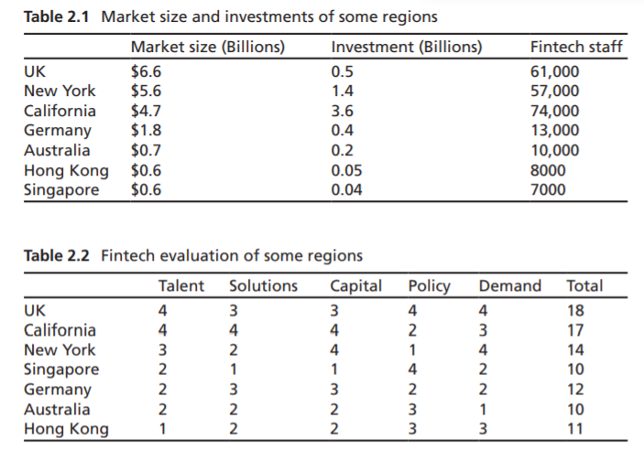
Market Size
Mrs.Disha Wankhede Department of Computer Engineering, VIIT, Pune-48

Slide 61
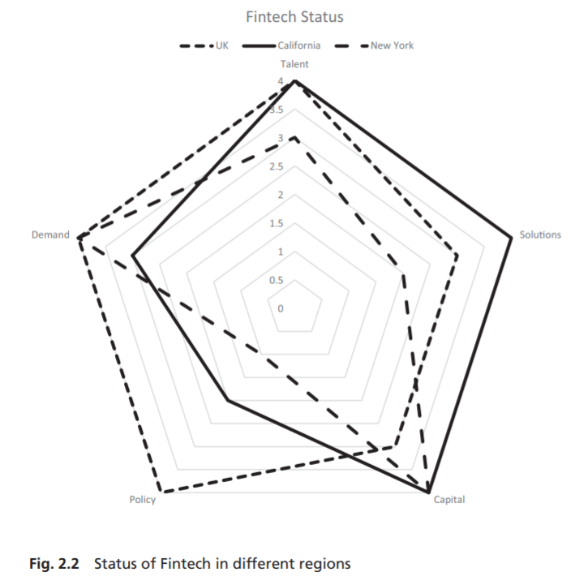
Mrs.Disha Wankhede Department of Computer Engineering, VIIT, Pune-48

Slide 62
Downsides of Disruptive Fintech Initiatives
In the case of fintech initiatives:
There are new risk exposures with fintech initiatives.
Financial services and market providers generally consider themselves fortresses.
Virtual door to similar activities.
The nature of attackers has grown.
Mrs.Disha Wankhede Department of Computer Engineering, VIIT, Pune-48

Slide 63
Downsides of Disruptive Fintech Initiatives
Deep risks connected with regulations .
Technology generally helps to go beyond traditional national borders.
National borders are less relevant from a technology point of view, but regulatory agencies on all sides are keeping a close watch.
International sovereignty aspects, legal jurisdiction, customer data protection, and taxation.
Risk management on their agenda currently are a perceived barrier to fintech initiatives
Mrs.Disha Wankhede Department of Computer Engineering, VIIT, Pune-48

Slide 64
Downsides of Disruptive Fintech Initiatives
There is a cultural challenge .
Risk losing competitive advantage by allowing their financial environment to become non-competitive in the global marketplace.
Example
Mrs.Disha Wankhede Department of Computer Engineering, VIIT, Pune-48

Slide 65
Reference
1. B. Nicoletti, The Future of FinTech, 1st ed. Palgrave Macmillan, 2017
2. Financial technology – Wikipedia
3. Albert Wang CTO, LionRock FinTech FINTECH: OVERVIEW
Mrs.Disha Wankhede Department of Computer Engineering, VIIT, Pune-48

